Slide 1



Transforming Early Detection of Cardiac Arrhythmias with AI-Powered E-Textiles
Jeanette Ortegon, Founder
Waverly Technology LLC
PRESENTER: Jeanette Ortegon Founder - Waverly Technology, LLC
Problem

Slide 2

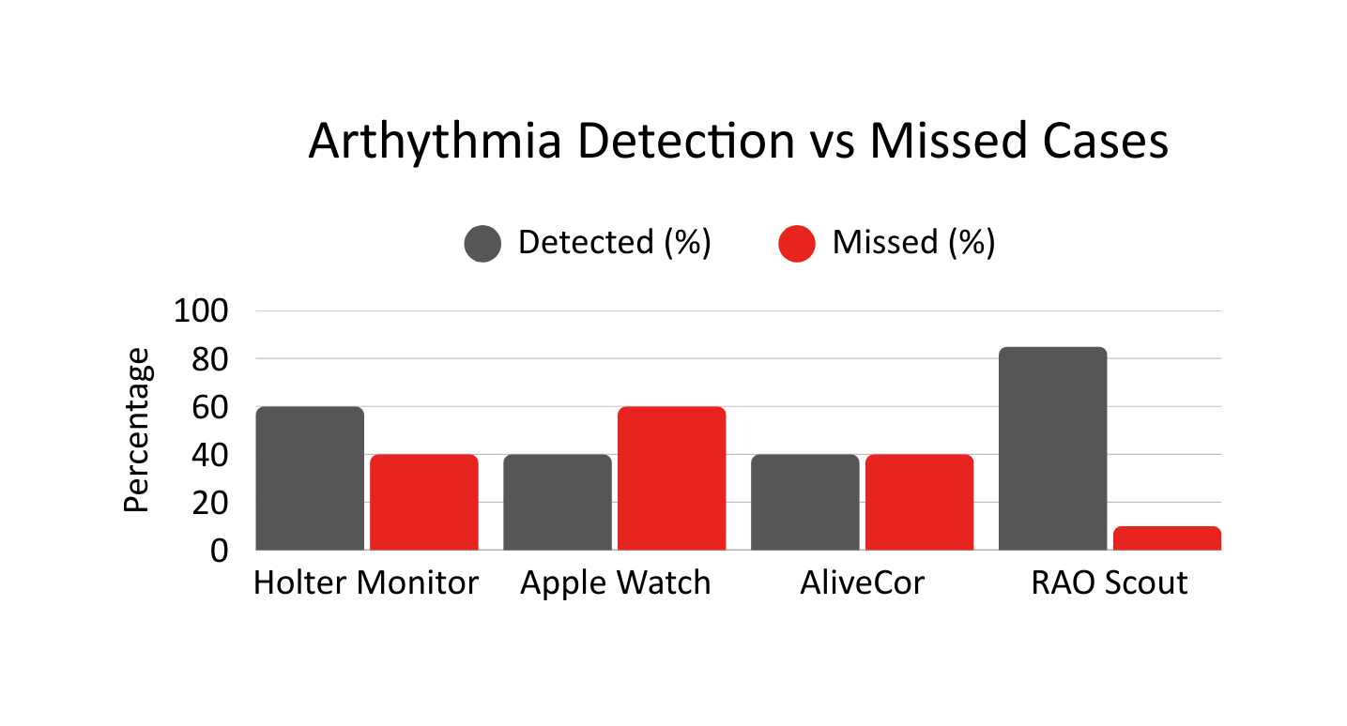
Problem
01
02
03
Millions of arrhythmias go undiagnosed each year
Current tools (Holter Monitor, Apple Watch, AliveCor) missed events due to short duration, poor adherence, or limited leads
Leading to avoidable ER visits, hospitalizations, and sudden cardiac deaths.
Solution
Missed Arrhythmias

Slide 3






Solution
Washable, textile-based garment with flexible hybrid electronics (FHE)
Garment Embedded Sensors
Flexible Hybrid
Electronics
Health
Monitoring App
User and
Healthcare Provider
Notifications
Features:
Wearable, everyday garment with embedded
sensors, lightweight, and the comfort.
Miniaturized, stretchable electronics integrated directly into fabric to continuously capture heart rhythms, vital signs, and biometric data.
Real-time transmission of health data via secure Bluetooth connection to a mobile app - providing instant analysis and personalized alerts.
Multi-lead ECG, Bioimpedance, SpO₂, AI-powered analytics.
Early warning alerts are sent directly to users and, optionally, shared with healthcare providers, enabling fast action before serious conditions
Develop.
Continuous, real-time monitoring with clinician-trusted accuracy.
Comfortable design ensures adherence—integrated into everyday wear.
Flexible Hybrid Electronics
Market

Slide 4
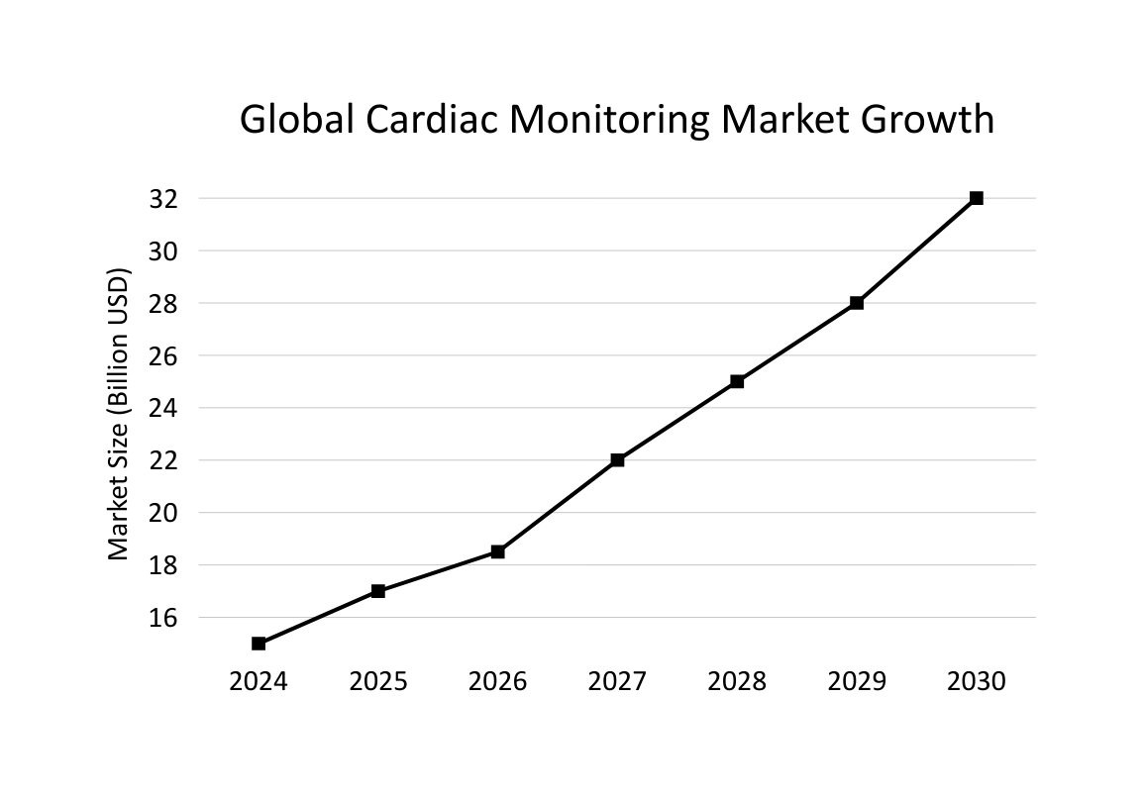

Market
Market Size:
Cardiac monitoring > $30B by 2030 (8–10% CAGR).
RPM Adoption:
Accelerated by CMS reimbursement & telehealth growth.
Target Segments:
Cardiologists, at-risk patients, researchers.
Smart Wearable ECG Monitors Market Size Report
Competition

Slide 5

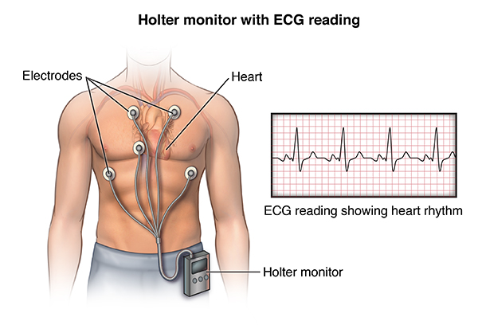
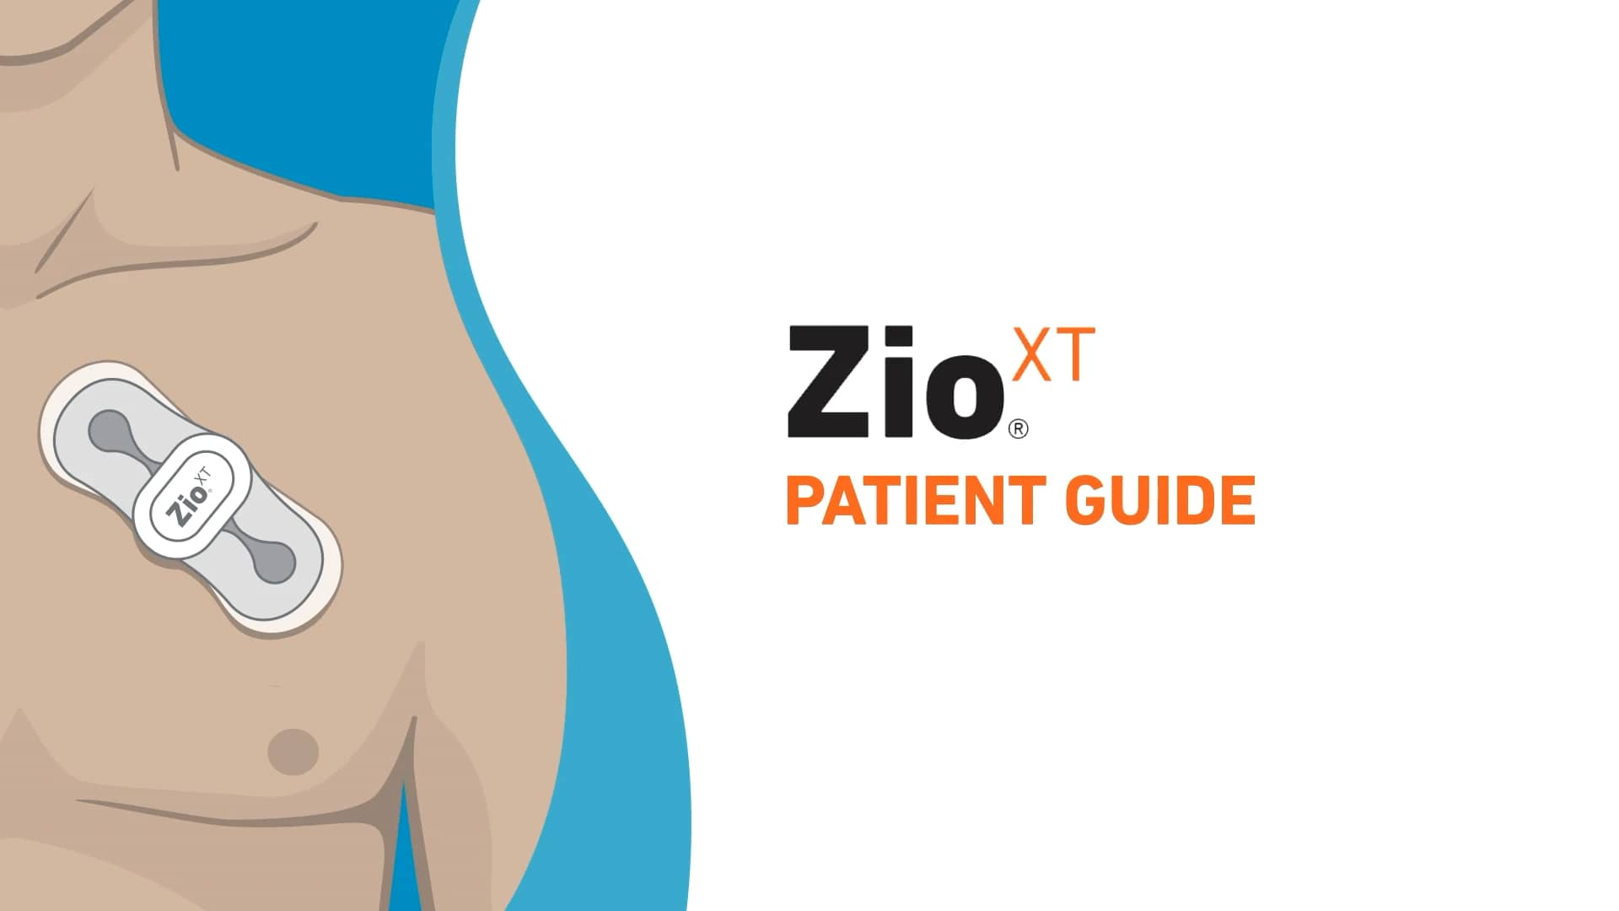
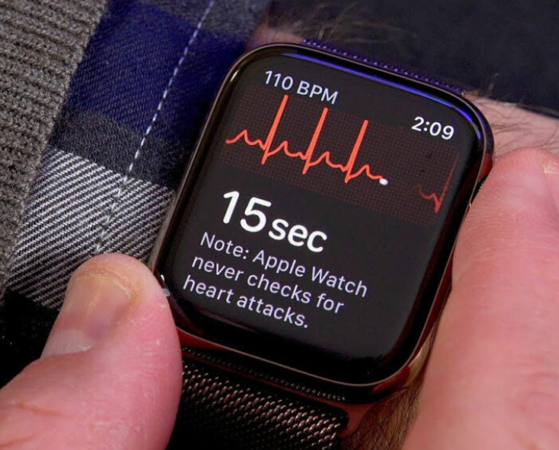
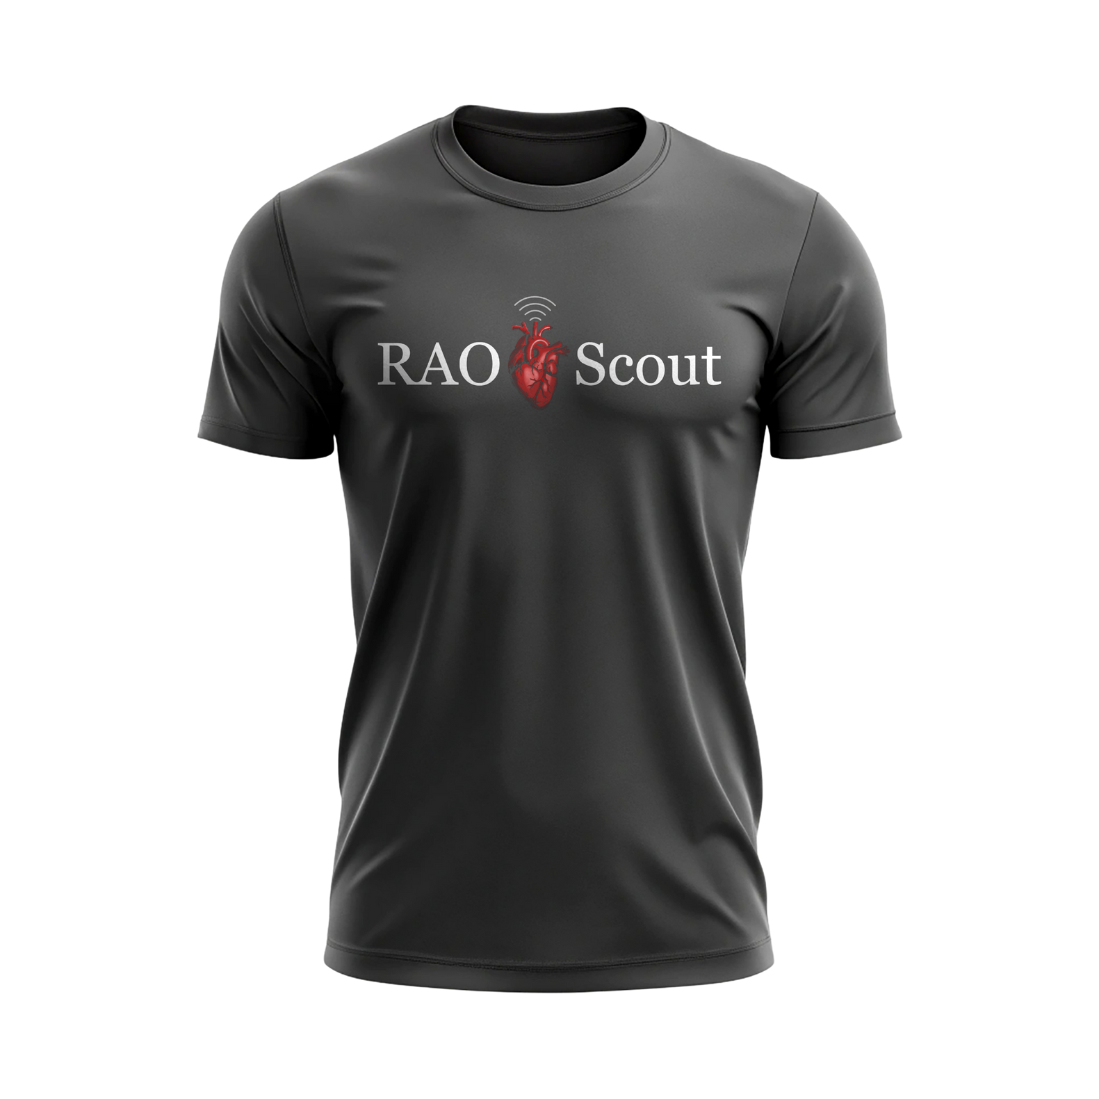
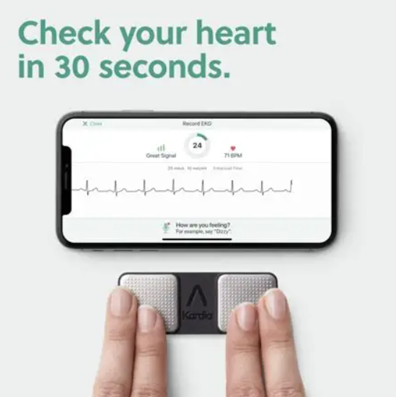
Competition
Competitors:
iRhythm (Zio Patch), AliveCor, Apple Watch,
Holter monitors.
RAO Scout Advantage:
Continuous, comfortable, multi-lead ECG,
AI-enhanced detection, reusable and durable.
Cardiac Monitoring Devices
Business Model

Slide 6



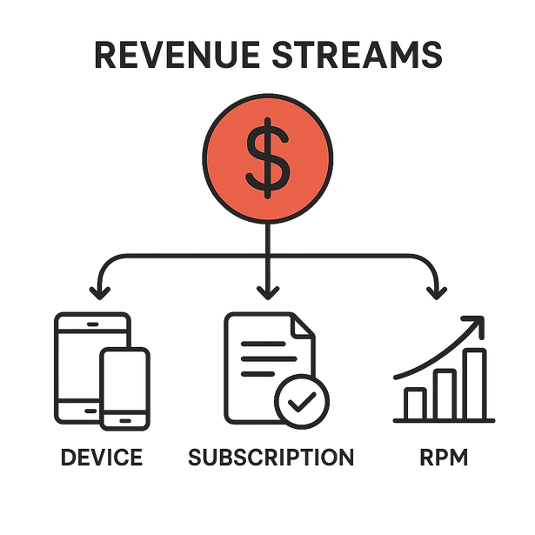
Business Model
Revenue Streams
Sustainability
Diagram
Device sales (~$200–$300/unit), subscription ($12–$33/month), and RPM reimbursements.
Partnerships with distributors & VA health Systems, U.S. manufacturing.
Team

Slide 7





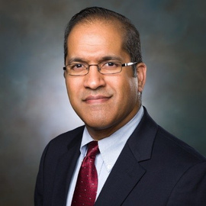




Our Team
Jeanette Ortegon
Lorenzo Gutierrez
Danielle Tucker
Founder, Waverly Technology, U.S. Navy Veteran
Sensor Technologist
Critical Care Nurse
Fehmida Kapadia
Chad Bonhomme
Shyam Bhakta
Mentor
Electrophysiologist
Cardiologist
Ask

Slide 8


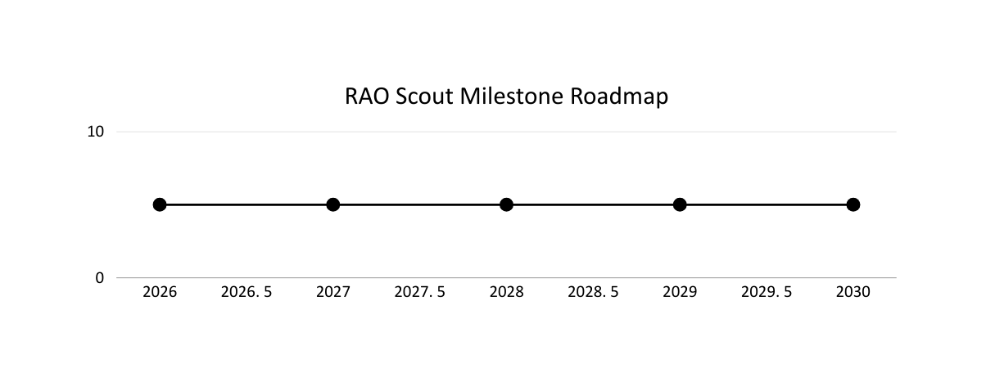
Seeking **$250K–$500K seed funding** to:
Validate prototype in clinical pilots.
Advance FDA regulatory pathway.
Scale U.S.-based e-textile manufacturing.
Expand cloud AI RPM platform.
Ask
2026: Clinical
Pilots
2027: FDA
Clearance
2028: Launch
2029: Scale
2030: International expansion
Financials

Slide 9
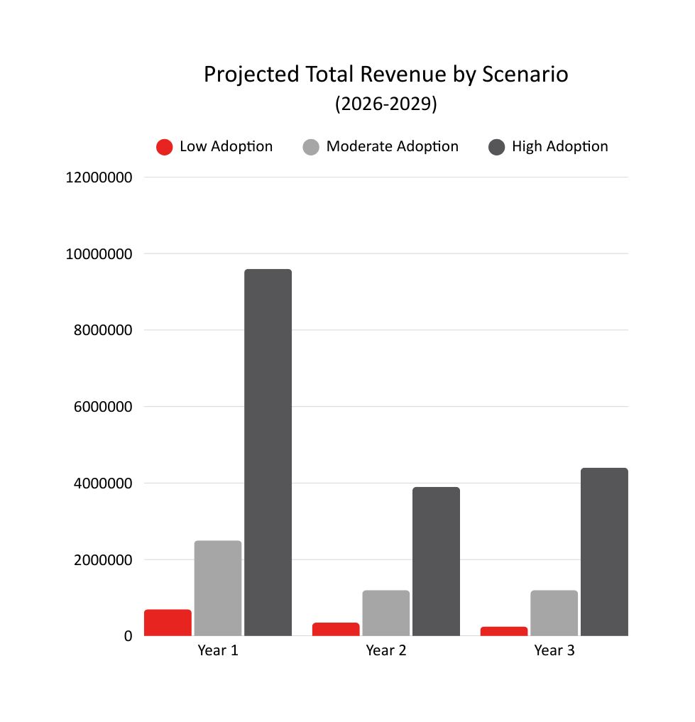

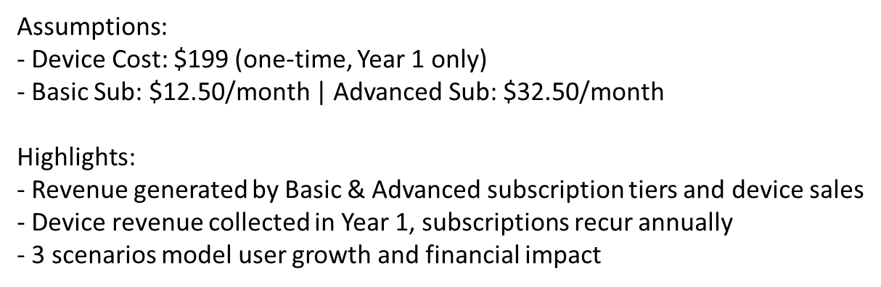
Financials & Milestones
2026:
Clinical pilots & FDA pre-submission.
2027:
Regulatory clearance & RPM integration.
2028:
Commercial launch, $5M projected revenue.
2029:
Scale manufacturing & expand international markets.
Closing

Slide 10

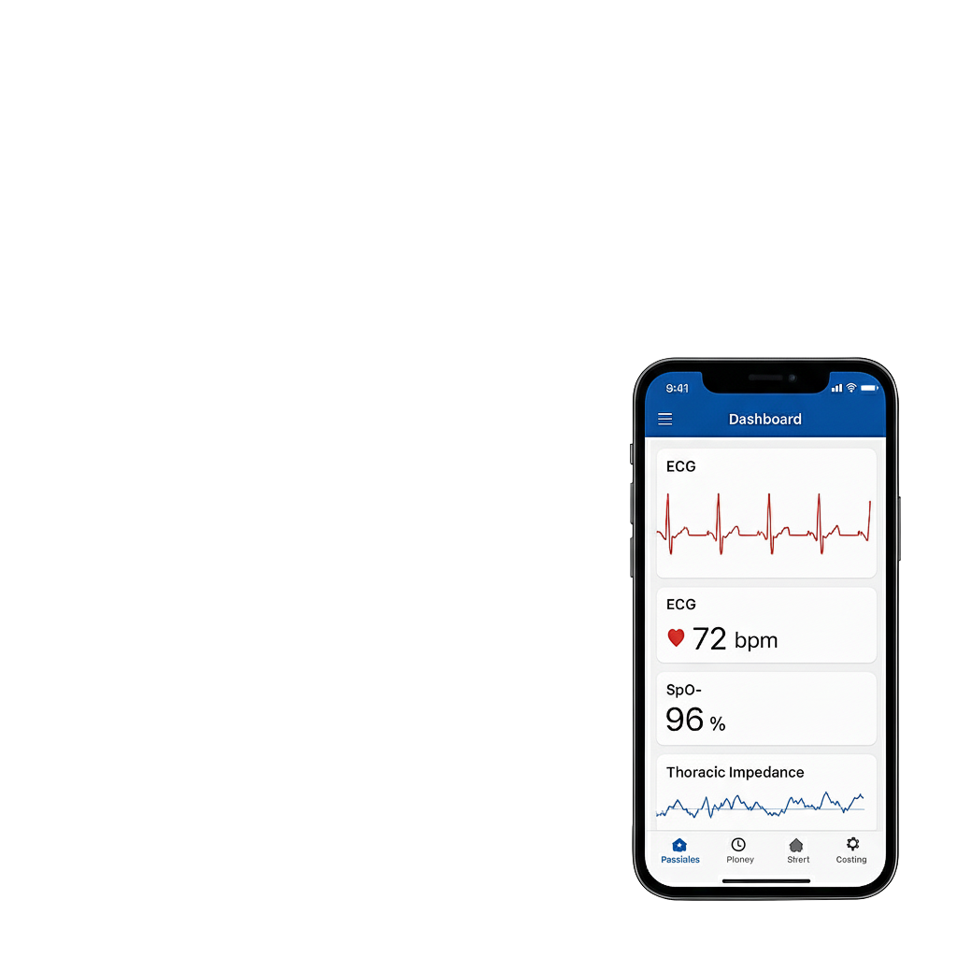
In Closing
RAO Scout saves lives by catching arrhythmias before they’re missed.
Clinically trusted, AI-powered, patient-friendly.
Scalable model, best solution for the underserved.
“Arrhythmia detection is a problem worth solving
so that every heart can beat”
Join us in transforming cardiac care.

Slide 11
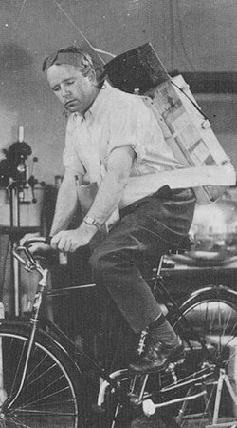
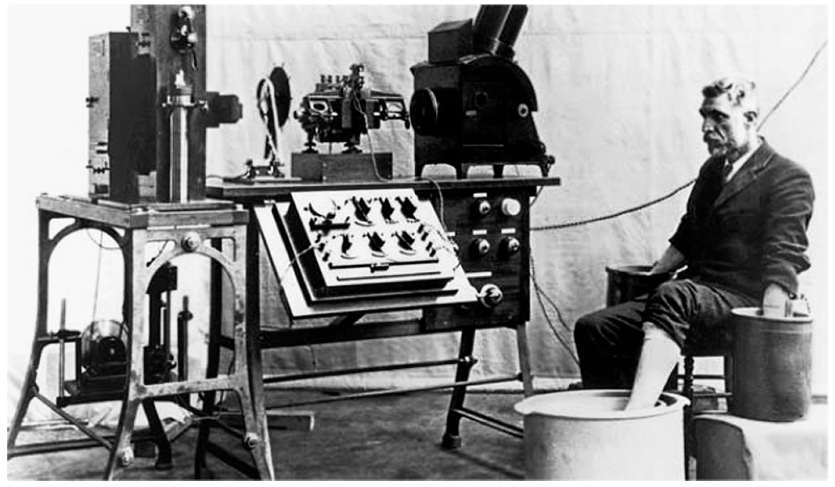
Questions
ECG Machine - 1903
Holter Monitor - 1962

